Slide 1
Seizing Continuous Integration to Improve Software Reuse
Master Thesis – Chair of Software Engineering
Piero Antonio Divasto Martínez
Notes:
Good afternoon everybody, my name is Piero Divasto and today I will present my Master Thesis which is about seizing continuous integration in order to improve software reuse.

Slide 2
Agenda
Introduction
Simile
Implementation
Demo
Search Results
Discussion & Future Work
Conclusion
Q&A
Agenda
Notes:
I will begin with and introduction where I will explain about software reuse, continuous integration, test-driven development and the question that gave born to this thesis.
After that I will describe the approach proposed in this thesis along with a usage scenario which we used for the implementation, a short demo of our proof-of-concept and the results.
To end with a discussion, future works and conclusions.

Slide 3
Introduction
How can Software Reuse and Continuous Integration be best married?
Introduction
Notes:
The question that triggered this thesis is the following: (question).
To solve this question we need to know what Software reuse and continuous integration mean.

Slide 4
Introduction – Software Reuse
Douglas McIlroy’s Vision in 1960s
Benefits
Lower costs and faster development
Higher quality
Standardize architecture
Risk reduction
What is a component?
It is any cohesive and compact unit of software functionality with a well defined interface
"Software reuse is the process of creating software systems from existing software (component) rather than building software systems from scratch” – Charles W. Krueger, 1992
Introduction
Notes:
The vision of building software using already existent software or components is nothing new. Douglas McIlroy was the first that came up with this idea in a
presentation called Mass Produced Software Components.
Why?
Cost reduction and faster development
Higher quality
Standardize architecture
And risk reduction

Slide 5
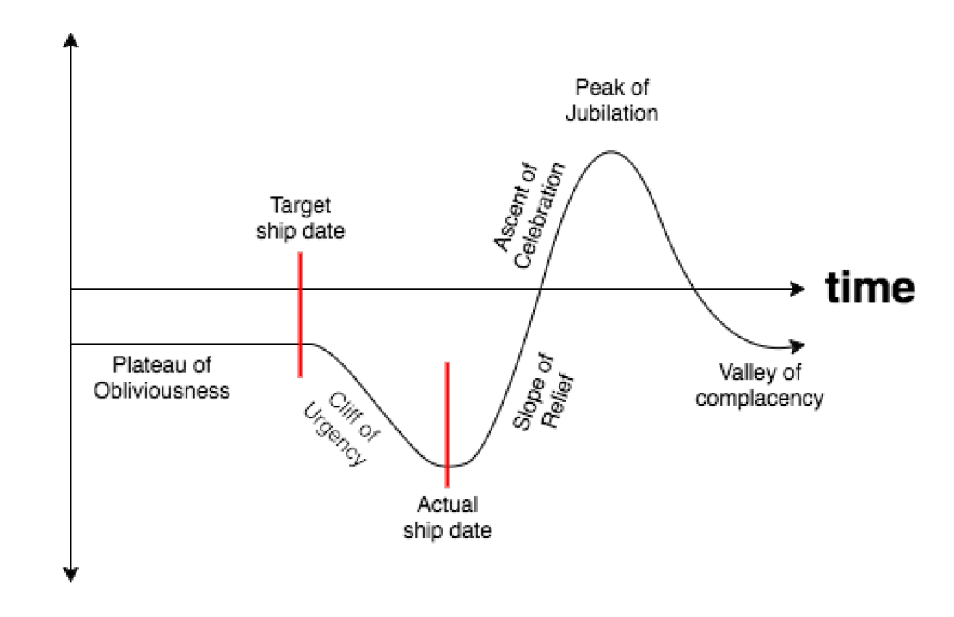
Introduction – Continuous Integration
“Continuous Integration is a software development practice where members of a team integrate their work frequently (…). Each integration is verified by an automates build (including test) to detect integration errors as quickly as possible.” – Martin Fowler, 2006
“Continuous Integration doesn’t get rid of bugs, but it does make them dramatically easier to find and remove.” – Martin Fowler
Benefits
Shorter time-to-market
Rapid feedback
Improve software quality
Improve release reliability
Improve developer productivity
Introduction – Continuous Integration
Notes:
Signicantly reduced integration problems
Develop cohesive software more rapidly.
Fail fast, but fail small

Slide 6

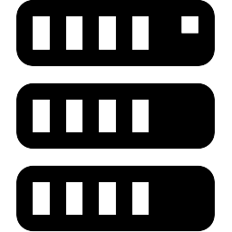
Introduction – Continuous Integration
4
TEST
SUCCESS/FAIL
5
3
BUILD
CI
Introduction – Continuous Integration
VCS
FEEDBACK
6
2
FETCH
CHANGES
D1
D2
D3
1
CHECK IN
CHANGES
Based on: https://insights.sei.cmu.edu/assets/content/image%20for%20continuous%20integration%20and%20devops_01262015.jpg

Slide 7







Introduction – Test-Driven Search
Developer
Choose
Component
Component retrieval approach
Alternative to keyword-matching and interface-driven search
Retrieves components with high precision
Heavy-weight
Test Cases
Reuse System
Introduction – Test-Driven Development
Extract
Interfaces
Test
Candidates
Search
Reuse Candidates
Compile
Candidates
Source: Oliver Hummel and Werner Janjic. Test-Driven Reuse: Key to Improving Precision of Search Engines for Software Reuse. In Finding Source Code on the Web for Remix and Reuse, pages 227{250. Springer New York, New York, NY, 2013
Notes:
- Component Retrieval technique
- Keyword-driven, interface-signature are not good enough
- Solution for the problem of retrieving many irrelevant results
- (explain cycle)
- High precision as candidates must pass the tests

Slide 8
Introduction – Test-Driven Development
Test-First Development
Refactoring
1
Test failed
5
(Re)write the test
Refactor some code
Tests passed
3
4
Write enough code to pass test
Check if all tests pass
Introduction – Test-Driven Development
Test passed
Tests passed
2
5’
Check if test fails
Test failed
Quality code
passed
Update failing tests
Some test(s)
failed
Based on: https://upload.wikimedia.org/wikipedia/commons/thumb/0/0b/TDD_Global_Lifecycle.png/1200px-TDD_Global_Lifecycle.png
Notes:
is a software development process
relies on the repetition of a very short development cycle

Slide 9


Simile
VCS
CI
Simile
COMPONENTS
Notes:
Interface-driven search
Lucene score -> determine how relevant a given Document is to a User's query
Test-driven search
Leanness based on instructions count (Needed Functionality/Necessary Functionality, [0, 1] - objective: maximize
Throughput -> operations/second
Cohesion LCOM3 -> Lack of cohesion in methods - measure how well the methods of a class are related to each other - A high LCOM value means low cohesion.
Efferent Coupling -> How many other classes are used by this class?

Slide 10

Simile
MEROBASE
RESULT WITH
COMPONENTS
SEARCH
COMPONENTS
FETCH
CHANGES
EXTRACT
INTEFACE-SIGNATURES
& TEST CASES
VCS
SEND DATA
CI
Simile
Simile
SOCORA
RANKED
COMPONENTS
CHECK IN
CHANGES
Interface-Driven search | Test-Driven search
Lucene score | Leanness default
 | Throughput
 | Cohesion LCOM3
 | Efferent Coupling
SIMILAR
COMPONENTS
Notes:
Interface-driven search
Lucene score -> determine how relevant a given component is to a User's query
Test-driven search
Leanness based on instructions count (Needed Functionality/Necessary Functionality, [0, 1] - objective: maximize
Throughput -> operations/second
Cohesion LCOM3 -> Lack of cohesion in methods - measure how well the methods of a class are related to each other - A high LCOM value means low cohesion.
Efferent Coupling -> How many other classes are used by this class?

Slide 11
Simile
Simile

Slide 12


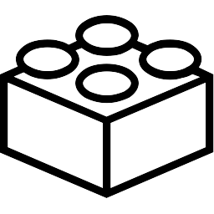

Simile - Demo
MEROBASE
FETCH
CHANGES
RESULT WITH
COMPONENTS
SEARCH
COMPONENTS
EXTRACT
INTEFACE-SIGNATURES
& TEST CASES
SEND DATA
Simile
Simile
SOCORA
Simile Jenkins
Plugin
RANKED
COMPONENTS
CHECK IN
CHANGES
SIMILAR
COMPONENTS

Slide 13
Discussion & Future Work
Is Simile beneficial?
Pros
Unobtrusive
Leverages TDD
High precision of candidate components – Merobase
Ranked candidate components – SOCORA
High adoption rates of CI/CD
Cons
What if the team does not use TDD?
Test-Driven search is a high-weight task
Bad quality of candidate documentation
Discussion & Future Work
Notes:
Survey made by company called Perforce 65% of companies have adopted CI/CD in some or all projects
40% of open-source projects in Github have also adopted Continuous Integration

Slide 14
Discussion & Future Work
Support other programming languages
Javascript, Scala, etc…
Support other CI servers
Travis CI, Teamcity, etc…
Support other VCS
SVN, Mercurial, etc…
Improvements in Test-Driven search
Further testing
Allow user to select non-functional requirements
Discussion & Future Work
Notes:
Although the tool presented is still immature, we could say that it is indeed beneficial because:
It is an unobtrusive tool because it analyses the code in background without disturbing the work of the developer.

Slide 15
Conclusion
Novel approach that improves the chances of reusing software.
It extracts interface-signatures and test cases to retrieve similar components.
Benefits
Reduction of cost of development
Reduction of time of development
It does not require reuse-awareness of developers
Unobtrusive
It needs further testing and improvements.
Conclusion

Slide 16
Questions?
Seizing Continuous Integration to Improve Software Reuse
Master Thesis – Chair of Software Engineering
Piero Antonio Divasto Martínez

Slide 17

Technology
Simile
Simile Jenkins Plugin
Deploy
JavaParser
CUID-Java
Guava

Slide 18
Base64.java
public class Base64 { public char[] encode(byte[] decoded) { // --- } public byte[] decode(char[] encoded) { // --- } }

Slide 19
Base64Tests.java
public class Base64Test { @Test public void test_rfc4648() throws Exception{ Base64 base64 = new Base64(); assertArrayEquals(chars(""), (char[]) base64.encode(bytes(""))); assertArrayEquals(chars("Zg=="), (char[]) base64.encode(bytes("f"))); assertArrayEquals(chars("Zm8="), (char[]) base64.encode(bytes("fo"))); assertArrayEquals(chars("Zm9v"), (char[]) base64.encode(bytes("foo"))); assertArrayEquals(chars("Zm9vYg=="), (char[]) base64.encode(bytes("foob"))); assertArrayEquals(chars("Zm9vYmE="), (char[]) base64.encode(bytes("fooba"))); assertArrayEquals(chars("Zm9vYmFy"), (char[]) base64.encode(bytes("foobar"))); assertArrayEquals(bytes(""), (byte[]) base64.decode(chars(""))); assertArrayEquals(bytes("f"), (byte[]) base64.decode(chars("Zg=="))); assertArrayEquals(bytes("fo"), (byte[]) base64.decode(chars("Zm8="))); assertArrayEquals(bytes("foo"), (byte[]) base64.decode(chars("Zm9v"))); assertArrayEquals(bytes("foob"), (byte[]) base64.decode(chars("Zm9vYg=="))); assertArrayEquals(bytes("fooba"), (byte[]) base64.decode(chars("Zm9vYmE="))); assertArrayEquals(bytes("foobar"), (byte[]) base64.decode(chars("Zm9vYmFy"))); } protected byte[] bytes(String s) throws Exception { return s.getBytes("ASCII"); } protected char[] chars(String s) throws Exception { return s.toCharArray(); } }

Slide 20
Domain Model

Slide 21
Microservices
Architectural style
Solution to Monolithic architectural style
Characteristics
Componentization via Service
Organized around Business Capabilities
Products not Projects
Smart Endpoints and Dumb Pipes
Decentralized Governance
Decentralized Data Management
Design for Failure
Benefits
Single responsibility
High scalability
Ease of deployment
Easy to enhance
Notes:
- microservice style aims to be as decoupled and as cohesive as possible

